Slide 1

FINAL PROJECT Instrumentasi
Muhammad Noor ( 05111850010003 )

Slide 2
Basic Componen - Game Space - Boundaries - Rule of Interaction - Artifacts - Goal

Slide 3
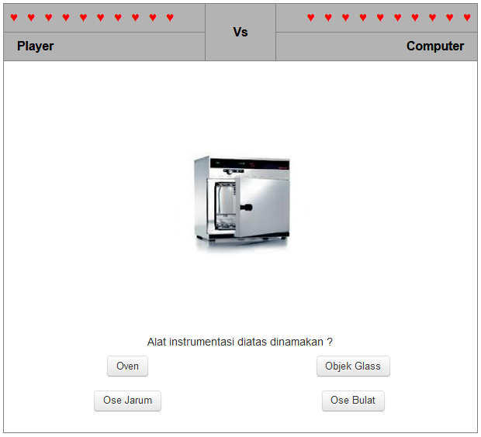
A. Game Space
A full-screen web-page that shows the board games, question, and answer button.

Slide 4
B. Boundaries
The Game plays when the player clicks the start button.
The board game consisting of 10 lives between player and computer that must be finished by the player with answering the questions.
Scoring based on the quality of answers.

Slide 5
C. Rule for Interaction

Slide 6

C. Rule for Interaction (Cont.)
The first step to start the game, the player must fill the login page by typing the student ID and password. If the Student ID and password entered correctly, the player will be directed to the Material map.

Slide 7
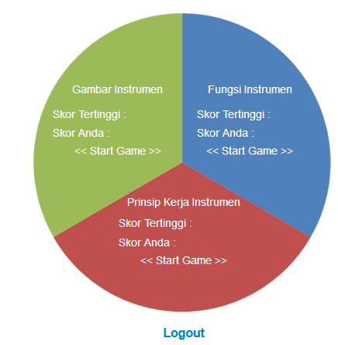
C. Rule for Interaction (Cont.)
The map consists of 3 material (picture, function, and principle) that player must complete. The player can play the game with press the start button.

Slide 8
C. Rule for Interaction (Cont.)
The game board. Player and computer have 10 lives. Choose the answer to the next question.

Slide 9
C. Rule for Interaction (Cont.)
The player can start the game by answering the random picture that appears. The player must choose 1 answer from the options button.

Slide 10


C. Rule for Interaction (Cont.)
The computer lives will be decreased if the player answers correctly.
Player lives decreased if the player chooses the wrong answer.

Slide 11
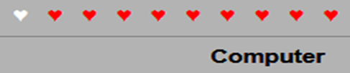
D. Artifacts
Atrifact | Symbol
Player’s Live
Computer’s Live
Question
Answer

Slide 12
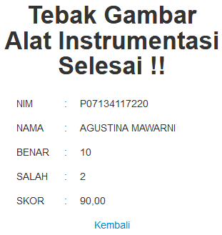
E. Goal
Result if the player completed the game. Player got information about the number of correct answers and the number of wrong answers and the final score.

Slide 13
Gameplay - Game’s Rules - Plot - Objectives - Challenges - Game Mechanics

Slide 14
Game’s Rules & Plot
A. Game’s Rules
The player wins if he is able to answer 10 questions correctly (computer live 0)
The player loses when giving 10 wrong answers (player live 0)
B. Plot
The player must complete 3 material (picture, function, and principle)
Player against the computer by answering questions
Player reduce computer life by answering questions correctly

Slide 15
Objectives & Challenges
C. Objectives
Choose the right answer to defeat the computer
Get a high score with giving the wrong answer as little as possible
D. Challenges
Random question
The player only has 10 lives which means the player only has 10 chances to choose the wrong answer
The computer has 10 lives which means the player must provide 10 correct answers to defeat the computer

Slide 16
Game Mechanics
E. Game Mechanics
1. Mobility
A player choosing 1 of 3 material in the map to start the game
The player can move to the next random question by choosing 1 of 4 option button at the bottom of the picture question
2. Question
Each material consists of several questions.
Each question consists of 4 answer choices button.

Slide 17
Game Mechanics (Cont.)
3. Scoring
To provide an assessment of student achievement, this application processes data obtained from the work of player and then calculates using the table :
True | False | Score
10 | 0 | 100,00
10 | 1 | 95,00
10 | 2 | 90,00
10 | 3 | 85,00
10 | 4 | 80,00
10 | 5 | 75,00
10 | 6 | 70,00
10 | 7 | 65,00
10 | 8 | 60,00
10 | 9 | 55,00
True | False | Score
9 | 10 | 50,00
8 | 10 | 45,00
7 | 10 | 40,00
6 | 10 | 35,00
5 | 10 | 30,00
4 | 10 | 25,00
3 | 10 | 20,00
2 | 10 | 15,00
1 | 10 | 10,00
0 | 10 | 00,00

Slide 18
Implementation and Testing - Participants - Testing Method - Evaluation Models

Slide 19
A. Participants
Participants form 4th-semester diploma IV at health polytechnic of Banjarmasin.
Participants consisting of 1 male and 20 females

Slide 20
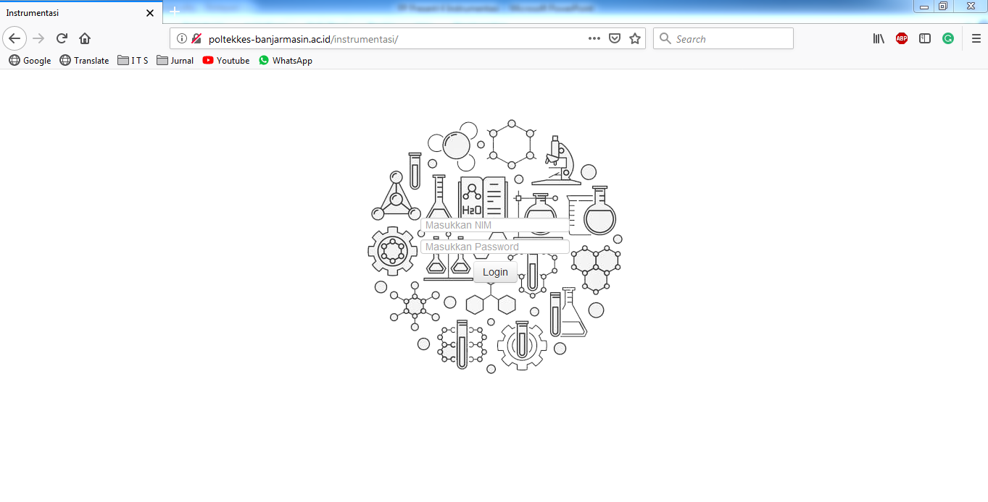
B. Testing Method
The application is run on a website. Application is distributed via internet networks.
Participants use the application through their computer that is connected to the server via the internet.
http://www.poltekkes-banjarmasin.ac.id/instrumentasi

Slide 21
C. Evaluation Model
In order to get feedback on the application, an evaluation is needed that explores how this application can have a positive impact on the participants.
There are 3 main things that are evaluated:
1. Stress levels of participants when playing the game evaluation
2. Experience following a game-based learning evaluation
3. Experience following learning evaluation using random questions.
Each main things are described in 4 specific questions that are answered with a statement that strongly agrees, agrees, disagrees, strongly disagrees.

Slide 22
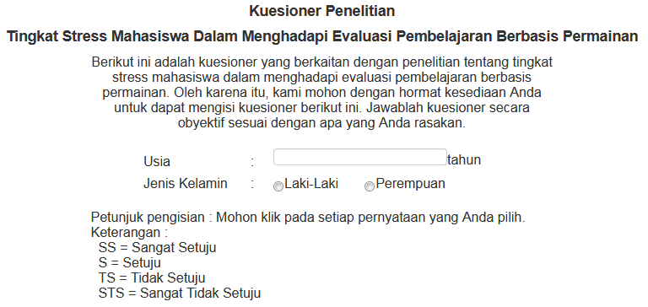
C. Evaluation Model (Cont.)

Slide 23
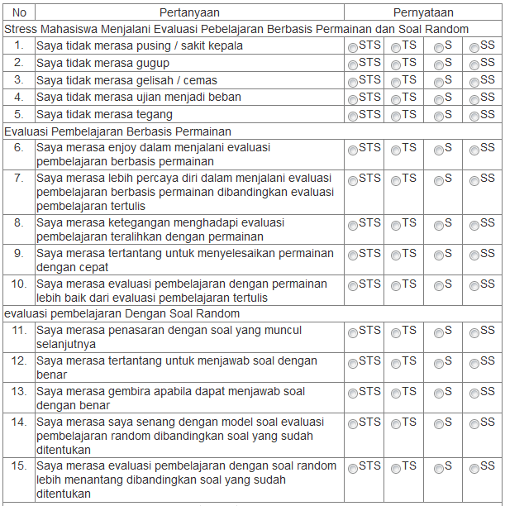
C. Evaluation Model (Cont.)

Slide 24
C. Evaluation Model (Cont.)
Scoring Likert
Max Score (Y) = Total Respondent * Max Score Likert
Min Score (X) = Total Respondent * Min Score Likert
Total Score = Sum (Total Responden * Score Likert)
Index (%) = Total Score / Y * 100
Interpretation
0 % - 24.99 % = Strongly Disagrees
25 % - 49.99 % = Disagrees
50% - 74.99 % = Agrees
75 % - 100 % - Strongly Agrees

Slide 25
Result and Evaluation - Result - Evaluation

Slide 26
A. Result
Instrument picture material

Slide 27
A. Result
Instrument function material

Slide 28
A. Result
Instrument work principle material

Slide 29
B. Evaluation
Stress Level
No | Question | ∑ | %
1 | I don't feel a dizzy / headache | 71 | 84.52
2 | I don't feel nervous | 73 | 86.90
3 | I don't feel anxious | 73 | 86.90
4 | I don't feel the test is a burden | 65 | 77.38
5 | I don't feel uptight | 69 | 82.14
 | Sum | 351 | 417.84
 | Mean | 70.20 | 83.568
 | Conclusion | Strongly Agrees

Slide 30
B. Evaluation
Game-Based Learning Evaluation
No | Question | ∑ | %
1 | I feel enjoy following the game-based learning evaluation | 68 | 80.95
2 | I feel more confident in following game-based learning evaluations than paper-based evaluation | 65 | 77.38
3 | I feel tension following evaluation of distracted learning with the game | 65 | 77.38
4 | I feel challenged to finish the game quickly | 68 | 80.95
5 | I feel that game-based evaluation is better than paper-based evaluation | 66 | 78.57
 | Sum | 332 | 395.23
 | Mean | 66.4 | 79.046
 | Conclusion | Strongly Agrees

Slide 31
B. Evaluation
Learning Evaluation using Random Question
No | Question | ∑ | %
1 | I feel curious about the question that appears next | 70 | 83.33
2 | I feel challenged to answer the question correctly | 69 | 82.14
3 | I feel happy when I can answer the questions correctly | 69 | 82.14
4 | I feel happy with the random question model compared to the predetermined question model | 66 | 78.57
5 | I feel the learning evaluation with random questions is more challenging than a predetermined question model | 65 | 77.38
 | Sum | 339 | 403.56
 | Mean | 67.8 | 80.712
 | Conclusion | Strongly Agrees

Slide 32
Conclusion
A game-based method using a computer can be used as one of the alternatives for learning evaluation because it has several advantages :
Participants feel enjoy using game-based learning evaluation (reducing stress)
Can help lecturer to check the score of students (immidiately known)
Reducing costs to print question and answer sheet
Give the participants maximum achievement

Slide 33
Terima Kasih Matur Nuwun Hatur Nuhun Thank You Shukraan Lak Danke XieXie Dhanyavaad Arigato Bedankt Grazie Gomawo Merci Blagodaryu Vas Gracias

